Slide 1

KVAR TECHNOLOGIES PRIVATE LIMITED
Company Profile

Slide 2
Who We Are
KVAR Technologies is engaged in the design, development and manufacture of embedded / micro controller based products primarily for industrial applications.
Having worked in this field for more than 25 years, we provide solutions for various control requirements in the process control industry. We manufacture electronic systems for automobile, industrial, medical, infrastructure and telecommunication applications. Our range of products is known for its sustainability to harsh industrial environments, low maintenance, accuracy and reliability.
Apart from standard products we develop, design and manufacture custom built products. Over the past years our company has recognized itself as a dependable source for OEM requirements

Slide 3


Our Expertise
With an experience of 25 years, we have expertise in providing solutions for control and monitoring requirements across the industry.
Our clients are spread all across the globe:
Canada
UAE
UK
USA
Thailand
Saudi Arabia
Africa
The clients of KVAR technologies share a relationship built on trust and faith.

Slide 4
Our Founders
Rajesh Doshi
Founder and CEO
Rajesh is an alumnus of College of Engineering, Pune. He completed his Masters from Indian Institute of Science in Electronic Designs from CEDT. He has twenty five years of experience in Electronics and Instrumentation industry and is known for his technical acumen in providing solutions which has helped the business in establishing itself in the market as solution providers to OEMs. He has in- depth knowledge and expertise in working with embedded systems which results in providing easy and user friendly answers to complex engineering situations. His philosophy of “be your own customer” and his unique ability in understanding customer concerns has resulted in providing solutions that enhance Productivity and processes in the manufacturing industry.
Swapna Karnik-Sankhe
Co-Founder and CFO / COO
Swapna is a Canadian CPA, CMA from Wilfrid Laurier University. She has over twenty years of experience working in Multinationals abroad. While in Canada, she has also worked for the Canadian Government. Her specialization in Management Accounting and experience in Management Information Systems makes her a valuable contributor to the Solution Building and Product Design process. Her philosophy is simple enhanced efficiencies result in increased productivity which leads to Shared Prosperity, the one which benefits both the employees and the customer. An articulate communicator and motivator, she has been capable of engaging and empowering employees to a high job satisfaction marker. She has been strong in directing and influencing the company’s vision and strategic planning.

Slide 5
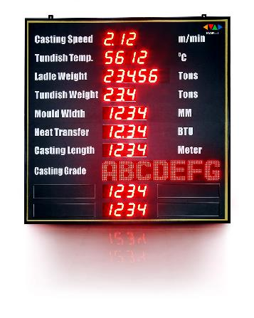
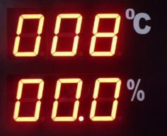
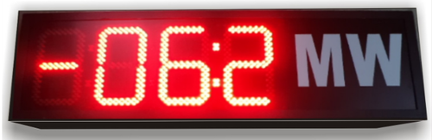
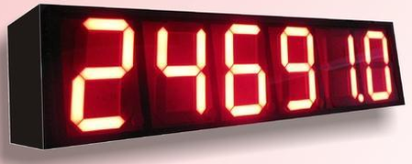
We Manufacture
Indicators
Temperature Indicator
RPM Indicator
Mega Watt Indicator
Humidity Indicator
Jumbo Indicator
Programmable Indicator
Temp-Humidity Indicator
Load Indicator

Slide 6
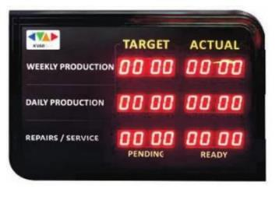
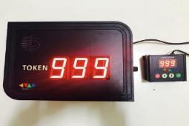
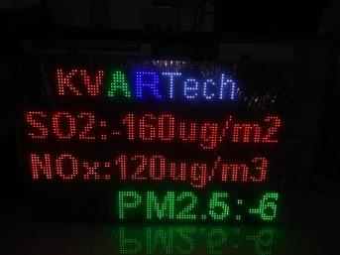
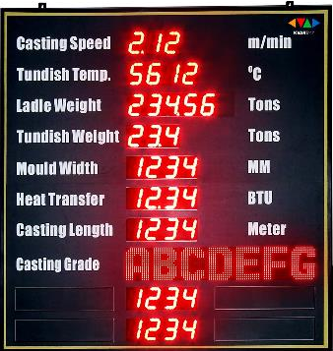
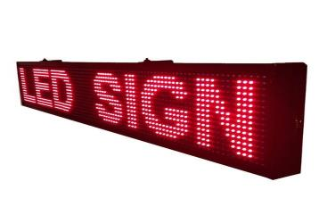
We Manufacture
Information Display
Production LED Display
Profibus Display
Scrolling LED Display
Token Display
Fixed Message Display
Food Waste Display
BED Number Display
Advertising Display
Elevator/ Lift Floor Display

Slide 7

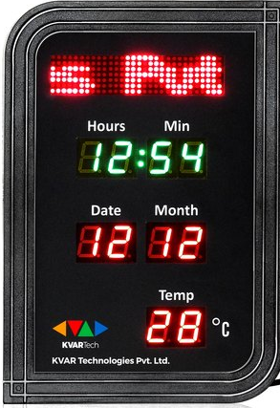
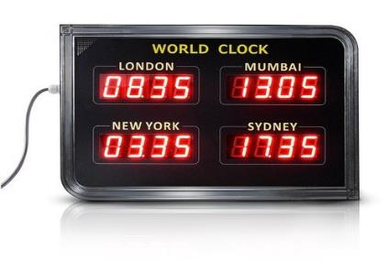
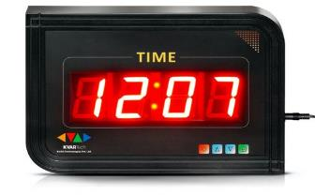
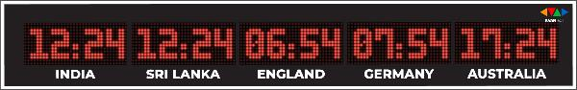
We Manufacture
Digital LED Clock
Smart Clock
Digital Clock
Temple Display
World Time Clock
World Clock with Scrolling Message Display
Synchronized Clock
GPS Synchronized Clock
Stopwatch Display

Slide 8
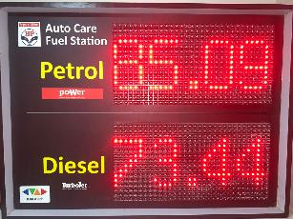
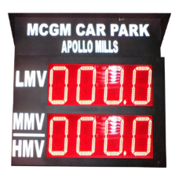
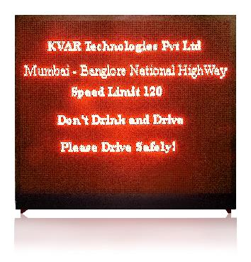

We Manufacture
Transport & Traffic Displays
GO & STOP Display
Taxi Advertising Display
Car Park Display
Truck Terminal Display
Toll Plaza Display
BUS Scrolling Display
Traffic Signal Countdown Display
Petrol Rate Displays

Slide 9
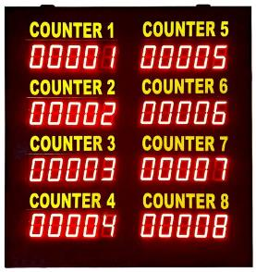
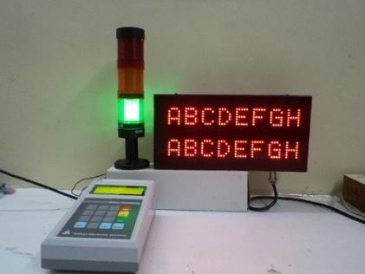
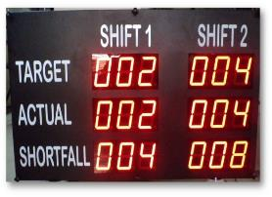
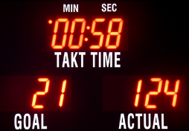
We Manufacture
Andon Production Displays
Target – Actual Display
LCD Andon Display
Takt Time Display
IOT Production Counter
Intelligent Tower Lamp

Slide 10
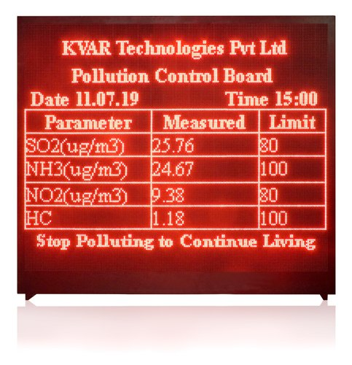
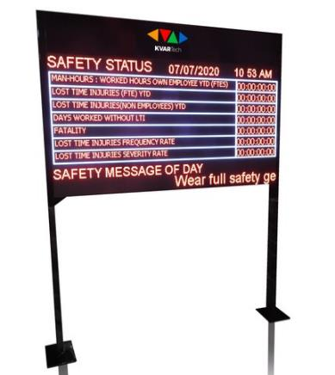
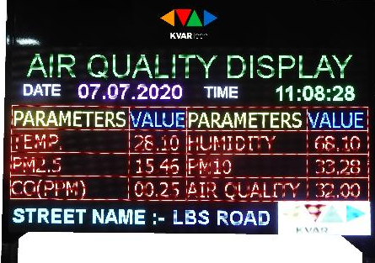
We Manufacture
Industrial Displays & Systems
Pollution Parameter Display
Safety Scoreboard Display

Slide 11
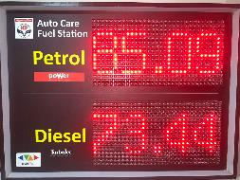
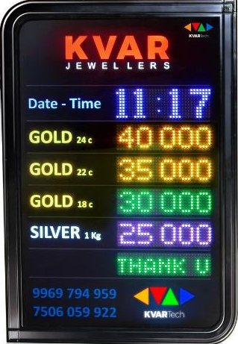
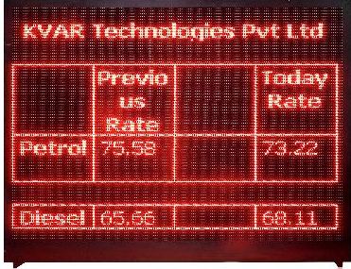
We Manufacture
Prize And Rate Display
Petrol Diezel Rate Display
Revenue Meter Display
Bank Interest Rate Display
Gold Silver Rate Display
Forex Rate Display
Dairy Products Rate Display

Slide 12
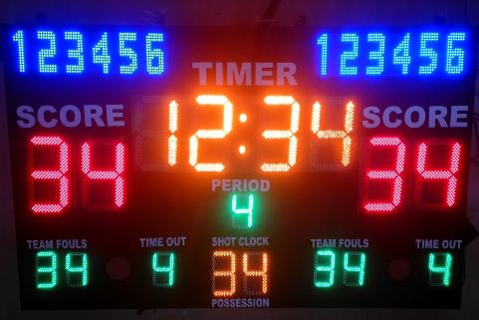
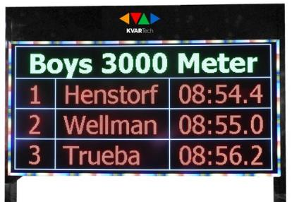
We Manufacture
Games Score Board Display
Score Board Display
Basket Ball Score Board Display
Foot Ball Score Board Display
Cricket Score Board Display
Badminton Score Board Display
Kabaddi Score Board Display

Slide 13
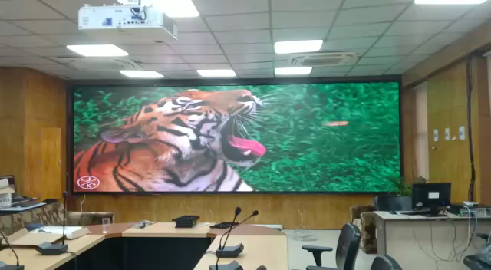
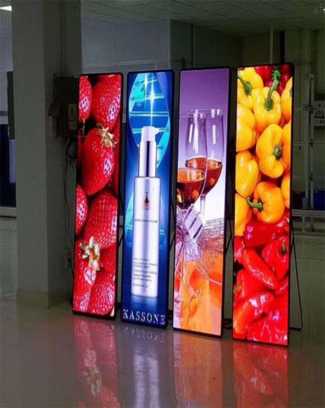
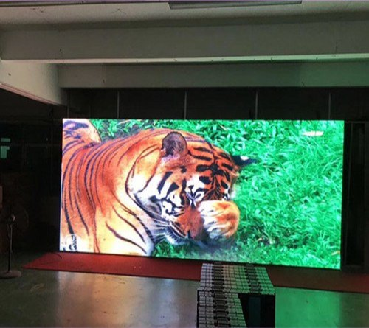
We Manufacture
Advertising Display
Customized LED Display
LED Standee
3D LED Fan

Slide 14
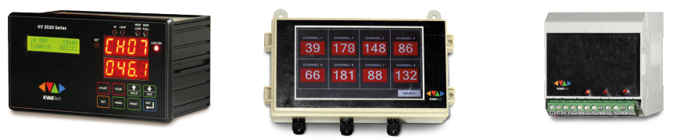
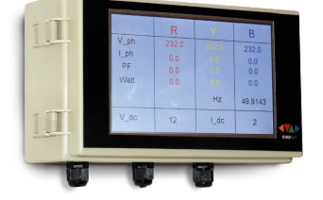
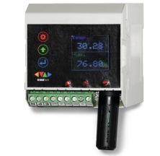
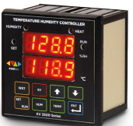
We Manufacture
Data Logger
Counter Logger
Level Logger
Universal Data Logger
RTD Data Logger
Modbus Data Logger
Touch Screen Data Logger
DIN Mount Temp Humidity Data Logger
Panel Mount Data Logger
Electrical Logger
GPS Data Logger
AC Voltage – Current Logger

Slide 15
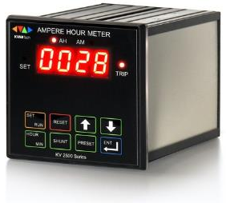
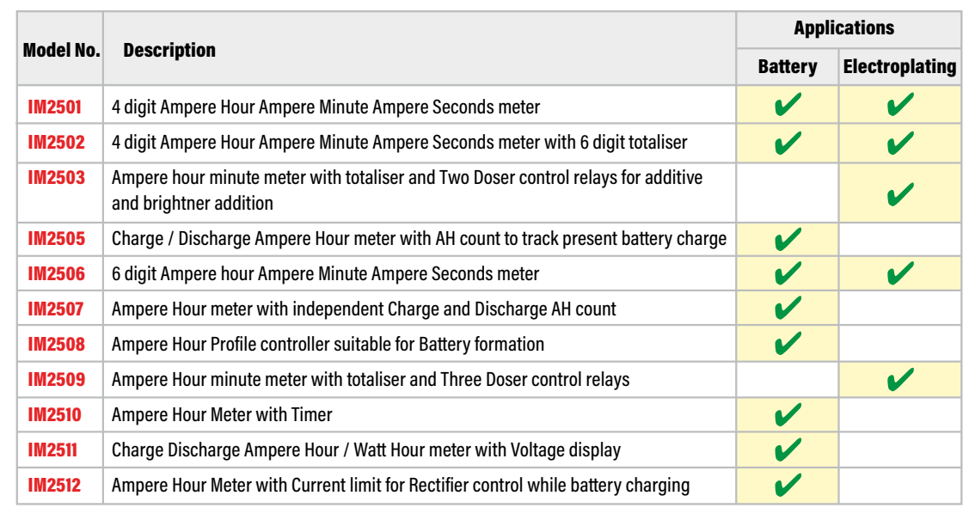
We Manufacture
Ampere Hour Meter

Slide 16
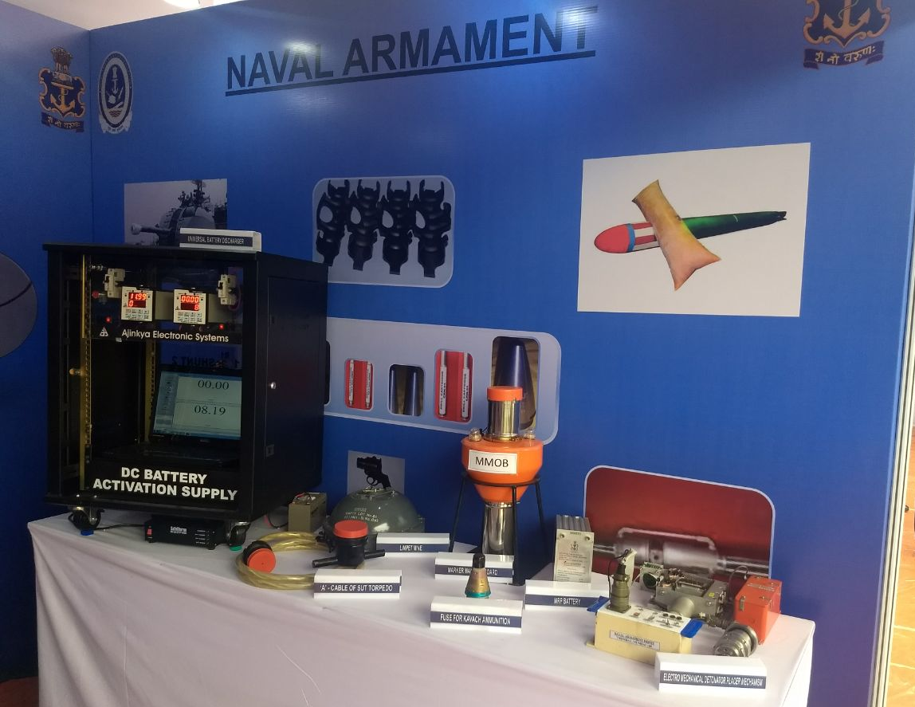
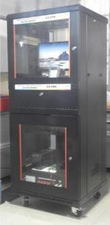
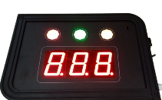
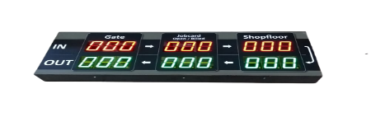
Our Merits in Industrial Electronics (to name a few)
An ISO 90001-2015 certified company with an high level of commitment to Quality
KVAR Tech products were showcased as one of the top tier innovative products by the Indian Navy.
Developed the indigenous RDPS systems for the first time for Indian Railways
First to make ECOS ( Electrical Vehicle Checkout Systems) in India replacing the Ford machine
First to offer Real Time switch for BEST
Developed Bay Monitoring System for Maruti Suzuki
Provided Score Displays for Parachute Landing Tournament which have been installed world over

Slide 17


Our Ongoing Projects
KVAR has identified the future of the market is going to be low power and wireless instrumentation and data is going to play a vital role in the days to come.
Keeping this in mind, company is now working on solutions for the Industry over various wireless platforms like LoRA, Wi-fi which form the basis of IOT or IIOT requirements of the market.
The products need to be more and more energy efficient as in the days to come the dependency of electronic products to operate on mains will be replaced by use of batteries and company has taken steps to make battery operated products.

Slide 18

What We Can Do For YOU?
Understand your requirement/issues
Design a suitable solution
Develop a prototype for trials
Produce a solution to meet the -
requirement
In short with our expertise in embedded system designing and system integration, we can add value to the products which need System integration and customized requirements.

Slide 19

THANK YOU
KVAR TECHNOLOGIES PVT. LTD.
Website : www.kvartech.com / www.kvartech.in
Phone : +91 22 2431 2031/ 2432 2320
Email : sales@kvartech.com

